Slide 1

Assessment Self-Presentation
Software Architecture L1
Pavlo Vilenchyk
November 2025

Slide 2
Introduction – Who I am
Current title: Lead Software Engineer
Current roles: Technical Lead and SME responsible for system analysis, modernization design, and migration of AS400 mainframe, components, ETL pipelines, and financial systems. Lead cross-team collaboration, guide technical decisions, and ensure scalable, reliable, and business-aligned solutions that support SafeRent’s long-term platform evolution.
Key Skills:
Legacy System Modernization Architecture
End-to-End Solution Design
Technical Leadership & SME Expertise
Enterprise Migration Strategy
Cross-Team Collaboration & Stakeholder Alignment
Data Integration & ETL Architecture
Certificates/Educational Programs:
Solution Architecture School #177 2024Q4 (US/CA)
Azure AZ-204 Cloud Developer
Implementing a Data Warehouse
Databricks fundamentals

Slide 3
Working Experience/Career Path
2008
Ukrainian Media Holding – Web solutions
Korrespondent.net football.ua (Solutions architect)
Title: CTO
2016
EPAM – CLGX-RPS (Team Lead)
Title: Lead Software Engineer
2023– present
EPAM – SFRN-DEVT (Team Lead, SME)
Title: Lead Software Engineer
2015
EPAM – EPM-RQUA (Key developer)
Title: Project Manager
2020
EPAM – CLGX-RPSM (Project Coordinator)
Title: Lead Software Engineer

Slide 4

Contribution to projects and achievements
EPAM – SFRN-DEVT:
Architectural Discovery & Design Analysis
Joined the project at its inception and led the discovery phase during the transition to EPAM.
Conducted deep structural analysis of legacy RPS components through collaboration with existing vendors, RPS architects, and business stakeholders.
Produced architectural documentation and diagrams that served as the blueprint of future modernization.
AS400 UI & Interface Modernization
Designed architecture for migrating AS400 RPG apps into a modern Angular SPA platform.
Ensured a dual-environment setup, supporting multiple databases simultaneously and enabling a smooth, low-risk transition to the new system.
The solution remains in production and continues to evolve, validating the robustness and forward-looking nature of the architecture.

Slide 5
Contribution to projects and achievements
EPAM – SFRN-DEVT:
Transition to EPAM Managed Services
Played a key role in preparing the full transition from third-party vendors to EPAM’s managed-services model.
Created complete system architecture diagrams and documented responsibilities across all vendor and internal teams.
Supported the migration of SRS solutions from the corporate CoreLogic environment to a dedicated client data center.
With clear documentation and architectural planning, the data-center transition was completed in six months, with me acting as SME for .NET and DB solutions.
was
main
Was

Slide 6
Contribution to projects and achievements
EPAM – SFRN-DEVT:
Data Flow & ETL Migration (SSIS / Pentaho)
Led a team of 10 developers to migrate AS400 jobs and custom tooling into standardized SSIS and Pentaho ETL workflows.
Developed a detailed WBS, conducted migration planning, and guided the team on data-flow design.
Demonstrated tech expertise across legacy systems, ETL pipelines, and modern data-integration patterns.
Billing System Migration (Oracle Fin → Sage Intacct)
Acted as SME and Software Architect for the full financial-system migration initiative.
Designed and oversaw data extraction, transactional capture, transformation/normalization to Intacct’s data model, and integration adaptation.
Managed parallel run, validation cycles, cutover execution, and post-migration support.
was
main
Was

Slide 7
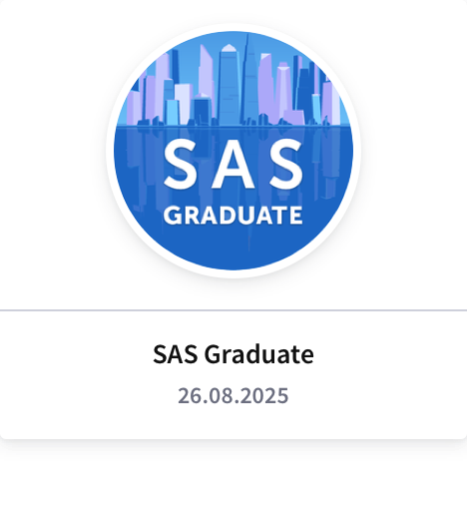
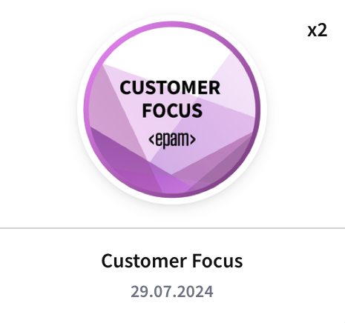
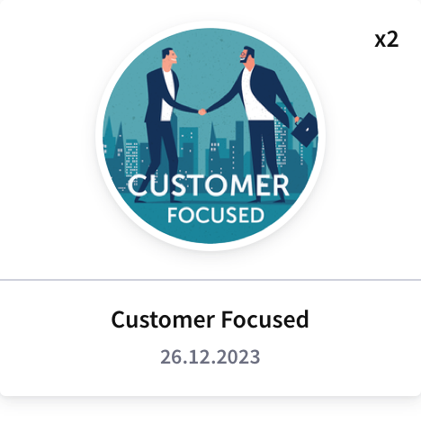
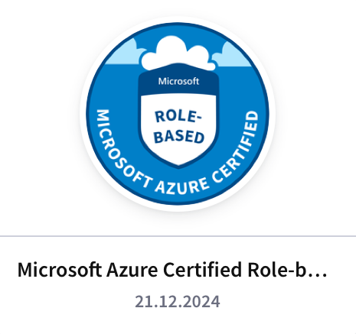

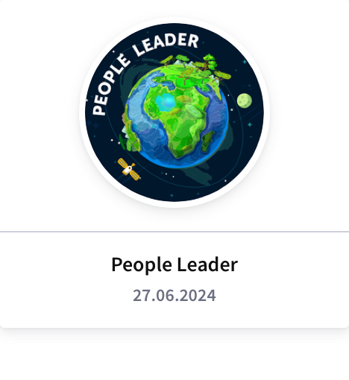
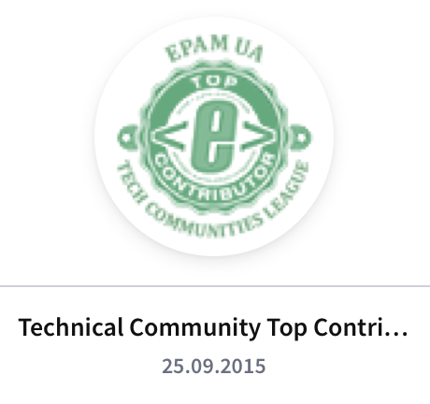

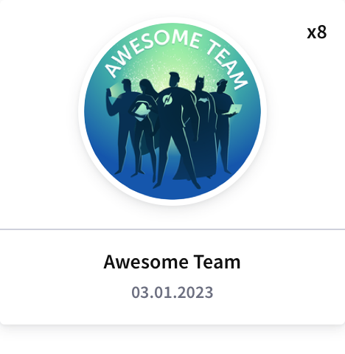
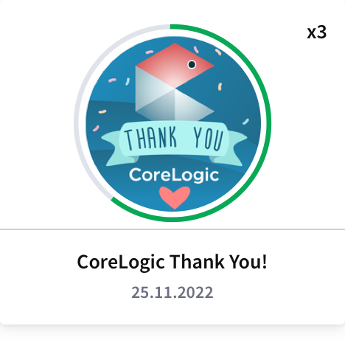
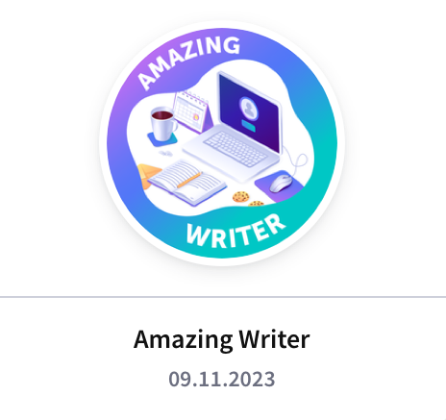
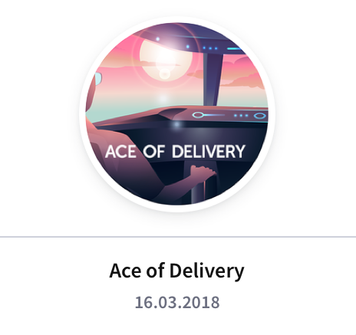
EPAM Badges

Slide 8
Summary – justification for promotion, goals for future
Demonstrated strong ownership of architecture and delivery across the SafeRent account, ensuring solutions align with business and engineering strategy.
Led legacy system discovery and modernization, defining scalable modern architectures.
Proactively identified and drove resolution of technical debt, generating additional value and revenue for EPAM.
Improved system maintainability, scalability, and reliability through clear architectural guidance and governance.
Effectively communicated with stakeholders, breaking down complex work and enabling timely, high-quality delivery.
Plan to expand architectural influence across more domains and strengthen governance and cloud-native modernization.
Aim to mentor engineering teams, drive innovation, and contribute to EPAM’s wider architecture community.

Slide 9
SFRN-DEVT: 2024. Client onboarding app. NewAccount
Business Drivers
Growing demand for faster, more accurate client onboarding across SafeRent Solutions.
Need to unify fragmented account-related interactions across Dynamics 365, Back-Office apps, Client-faced apps.
Pressure to improve operational efficiency, reduce onboarding errors, and increase customer satisfaction.
Business Goals
Standardize and automate the end-to-end client onboarding lifecycle.
Provide reliable, real-time synchronization of account data across all integrated systems.
Reduce manual processing and internal communication overhead for onboarding teams.
Increase transparency and traceability of onboarding status, actions, and notifications.
Ensure a scalable architecture capable of supporting long-term onboarding volume growth.
Business Objectives
Reduce the average onboarding completion time by at least 40% within 12 months.
Cut manual onboarding tasks performed by account managers by at least 50%.
Establish auditable, event-based communication flows (via Slack and internal logs) for all key onboarding milestones.
Deploy a modular, maintainable software architecture that supports iterative feature expansion.

Slide 10
SFRN-DEVT: 2024. NewAccount. NFR
Performance & Scalability
Support ≥50 concurrent onboarding sessions without degradation.
Horizontal scaling of API nodes; queue-based load smoothing for long-running actions.
Availability & Reliability
System uptime: ≥99% monthly for API and SPA.
No single point of failure: Redundant instances for API, queues, database.
Retry & idempotency: All integration calls (Dynamics, AAM, Slack) must be idempotent with retry policies.
Graceful degradation: If non-critical integrations fail (e.g., Slack), onboarding still proceeds with warnings.
Security & Compliance
Authentication: Federated via OAuth2/OIDC; short-lived tokens; refresh token rotation.
Secrets management: No secrets in code; all via secure GCP SM.
Usability & Accessibility
UI consistency: Follow internal design system; predictable flow.
Auditability & Traceability
Immutable history: Audit events must be immutable and stored for ≥3 years.
Operational traceability: Ability to reconstruct onboarding flows end-to-end.

Slide 11
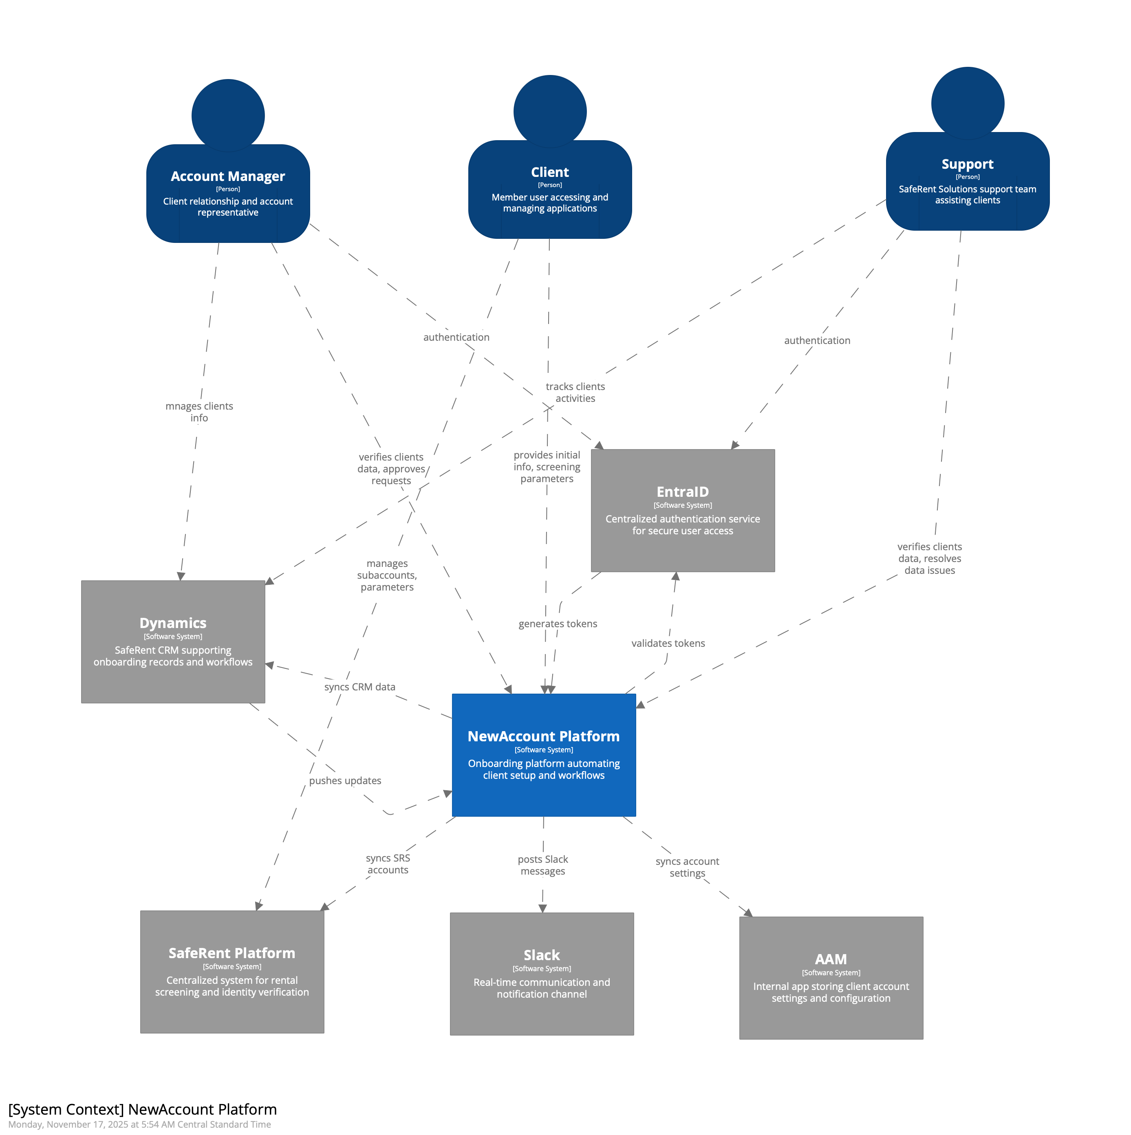
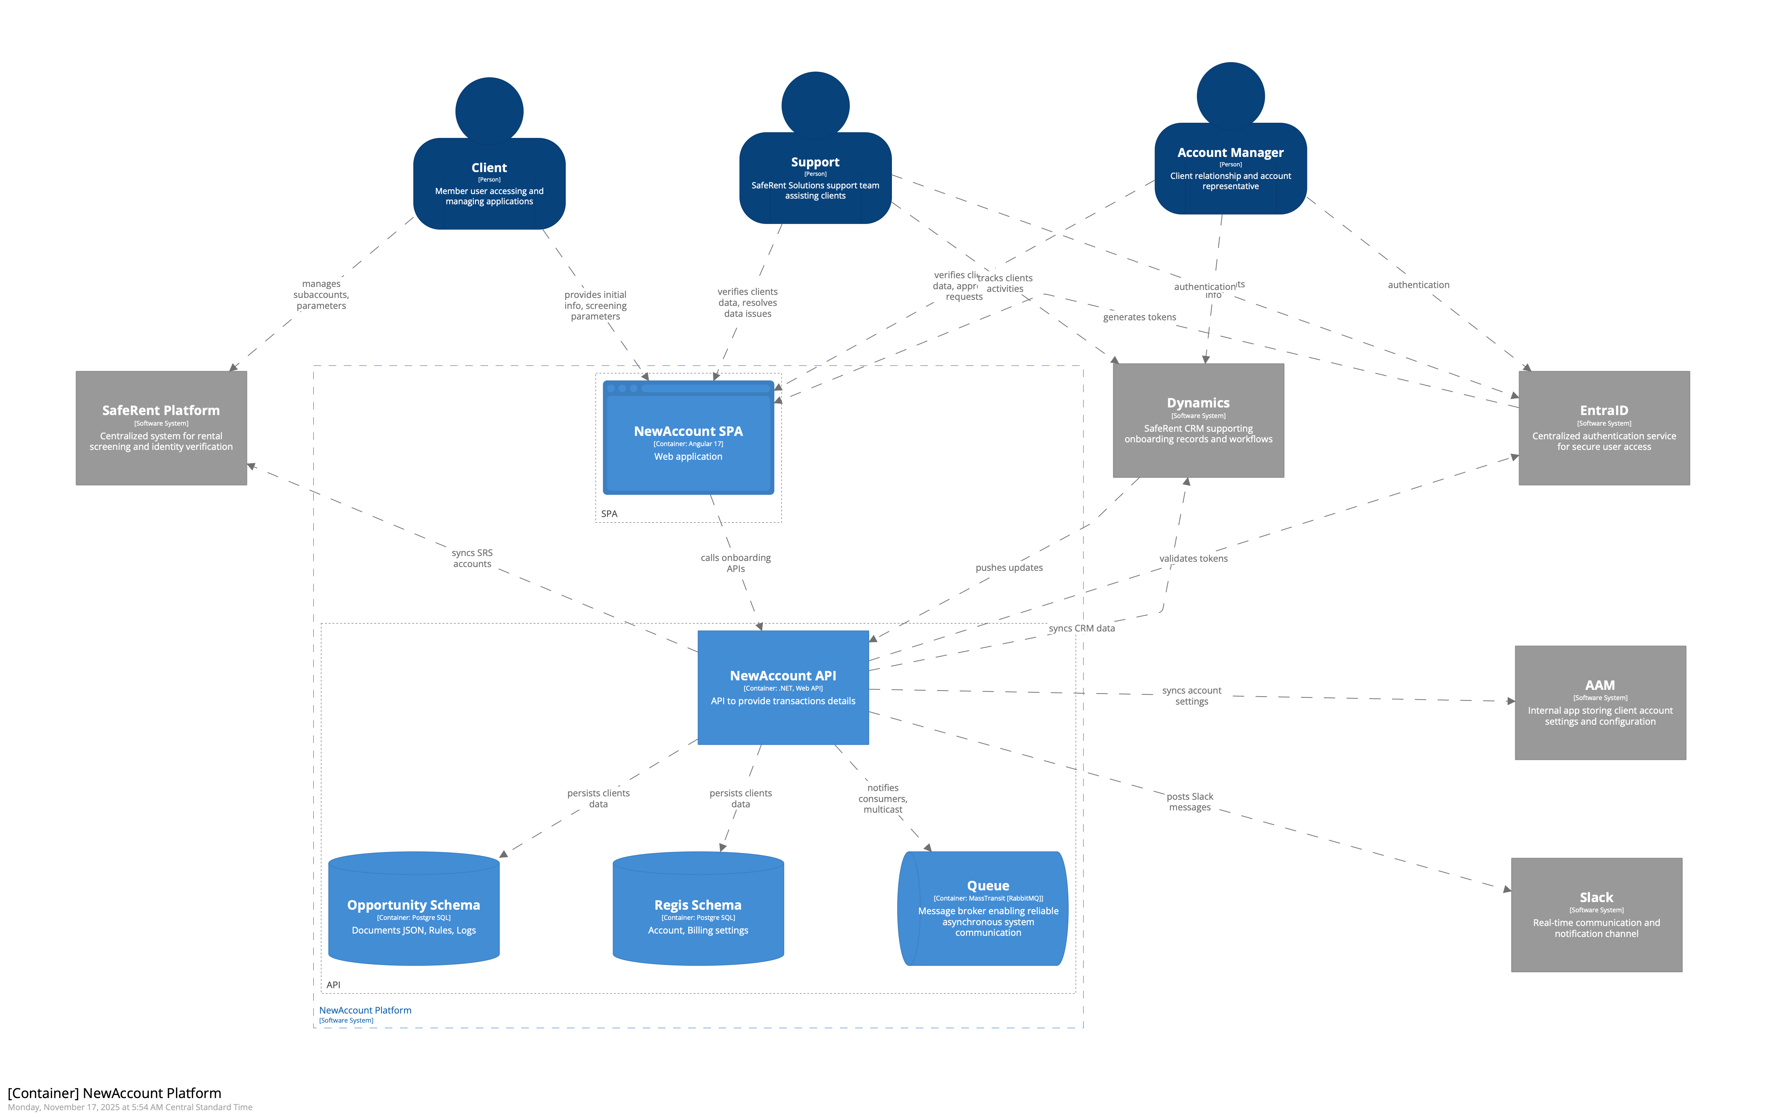
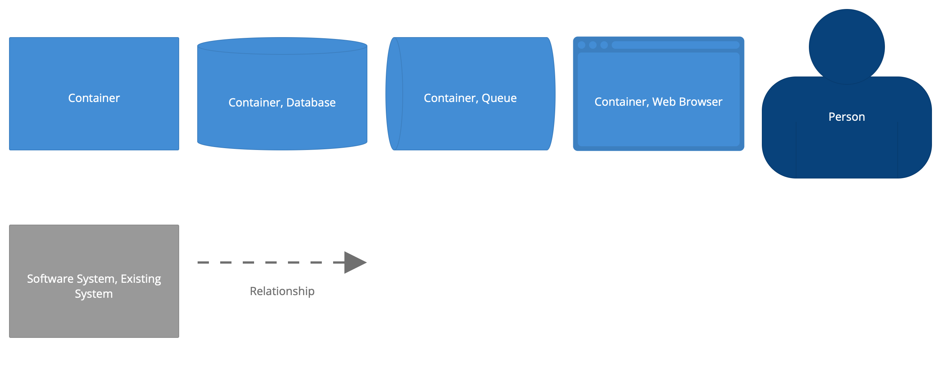
SFRN-DEVT: NewAccount. C4 diagrams
System context
Container

Slide 12
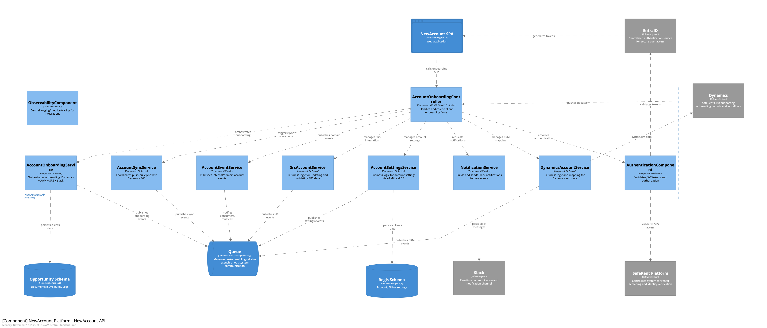
SFRN-DEVT: NewAccount. C4 diagrams
System context

Slide 13
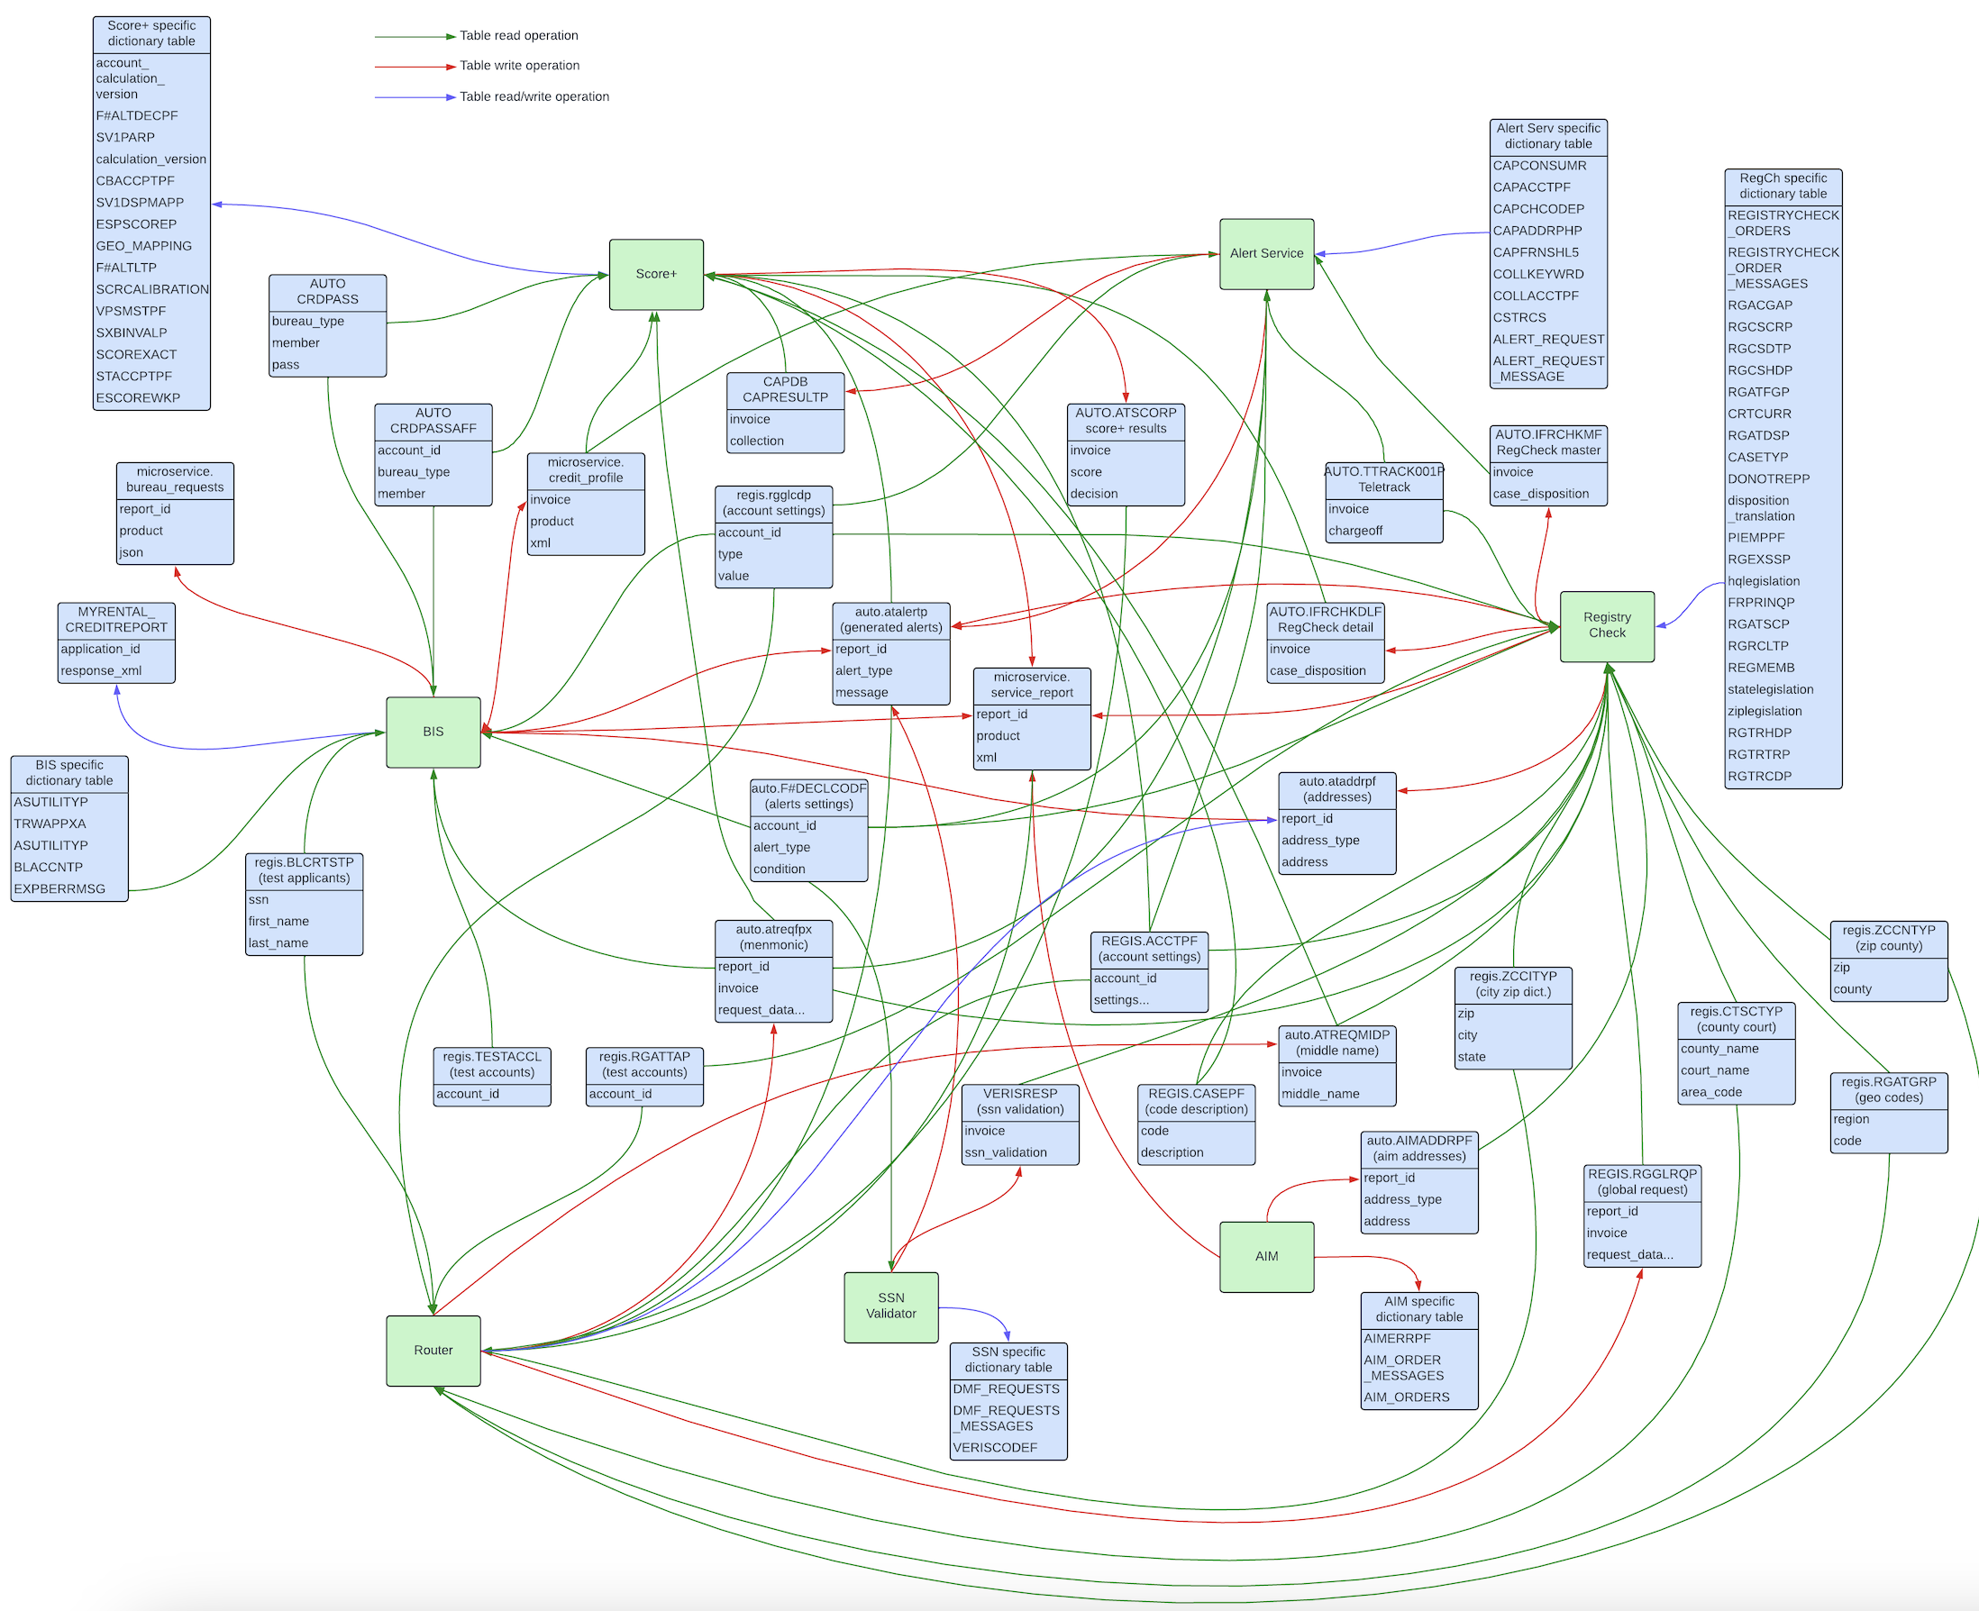
SFRN-DEVT: current state
Current architecture: dependencies between services diagram (DB tables).

Slide 14
SFRN-DEVT: non-functional requirements
Key quality attributes:
Performance: System must accept 40 requests per seconds and response back no longer than in 5 mins
Modifiability: System must be extendable and deliver new product to market no longer than in 1 month
Constraints: Technology stack must be Java, PostgreSQL, Linux to align with other client systems

Slide 15
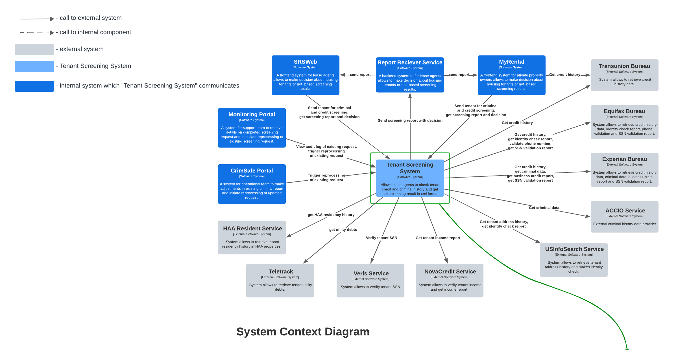
SFRN-DEVT: future state
Solution: system context diagram.

Slide 16
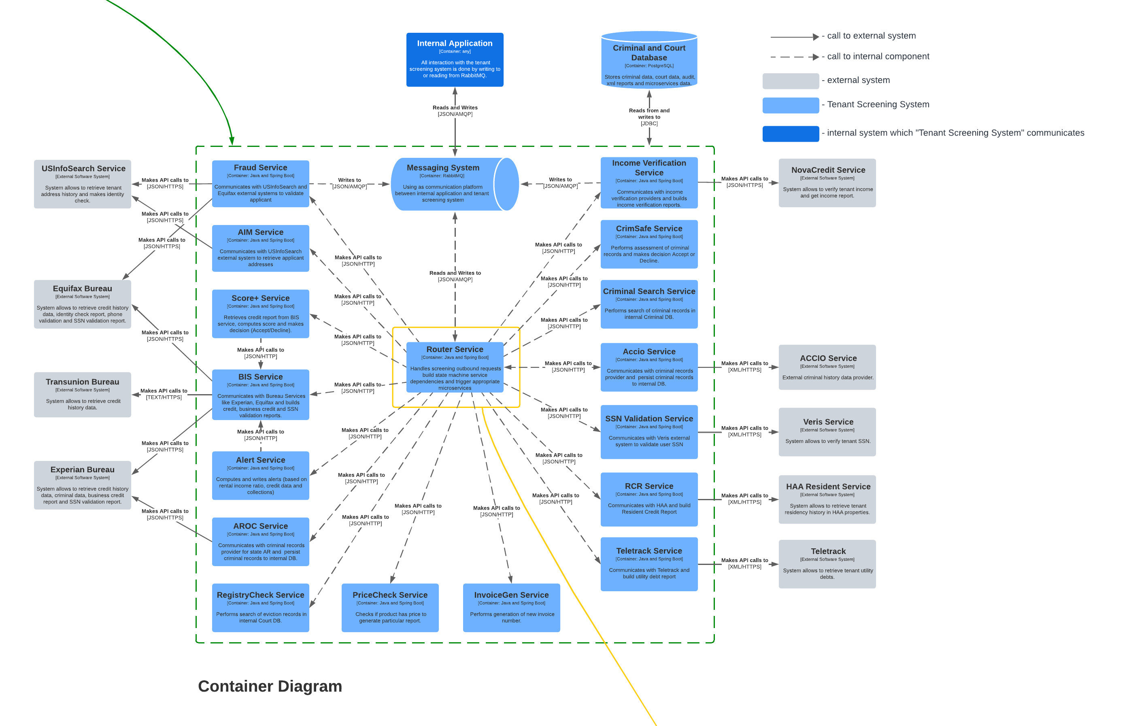
SFRN-DEVT: future state
Solution: container diagram.

Slide 17
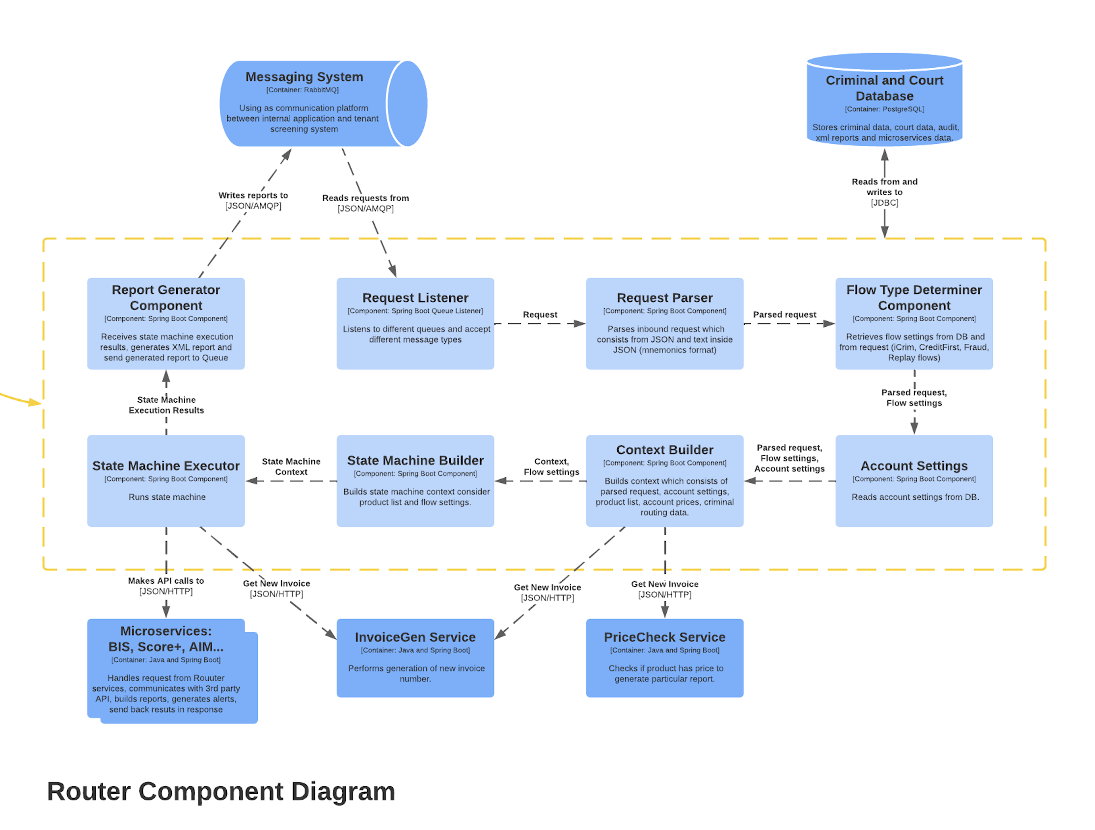
SFRN-DEVT: future state
Solution: component diagram.

Slide 18
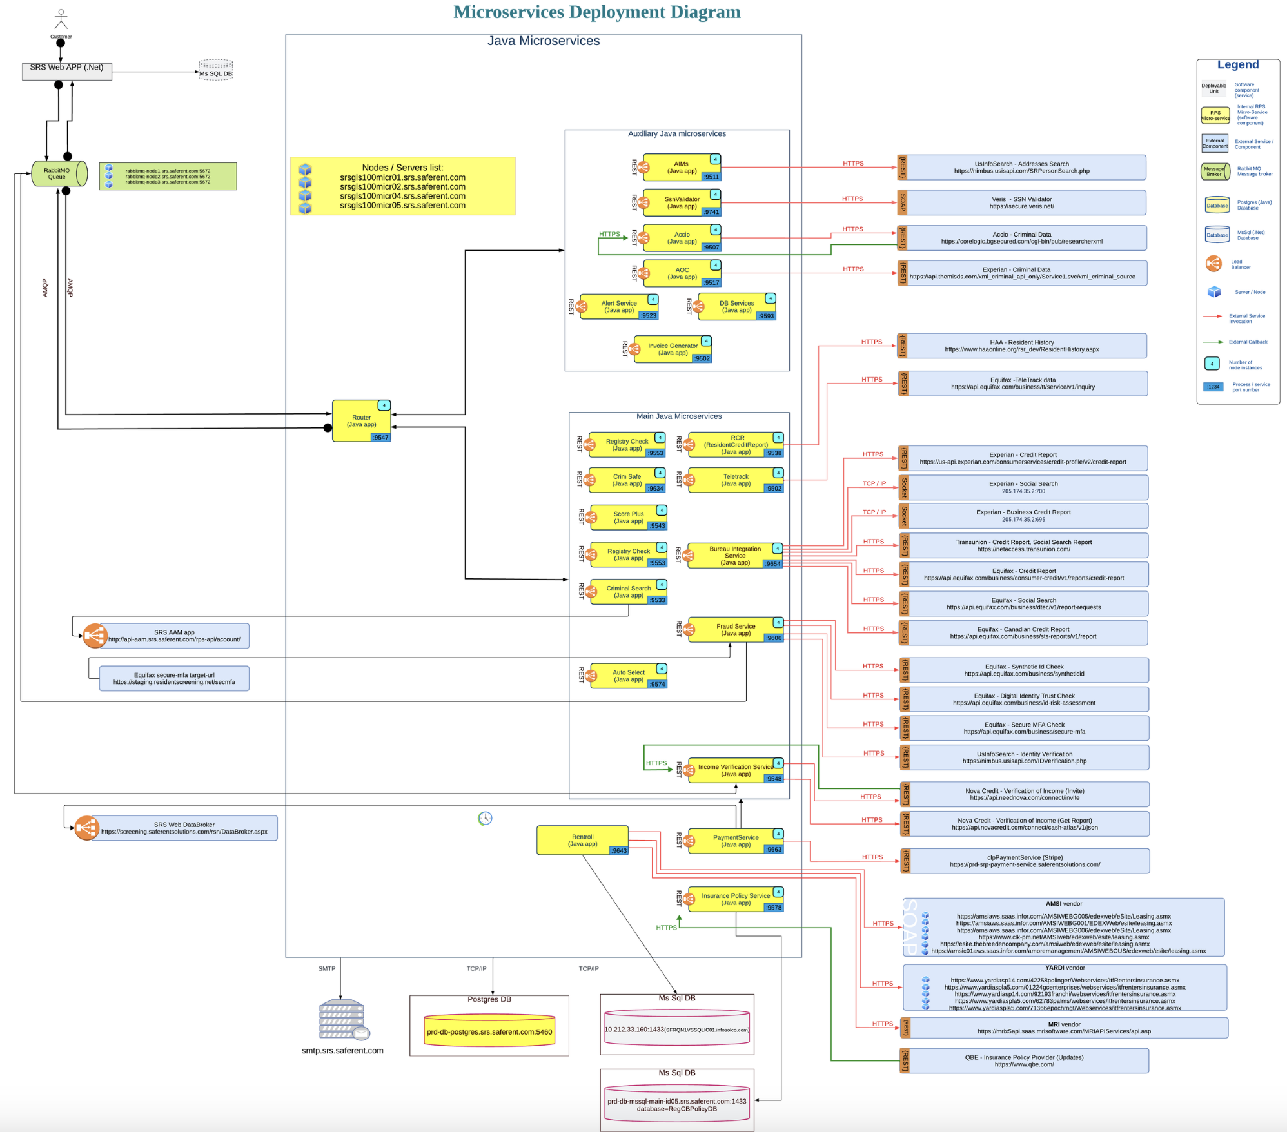
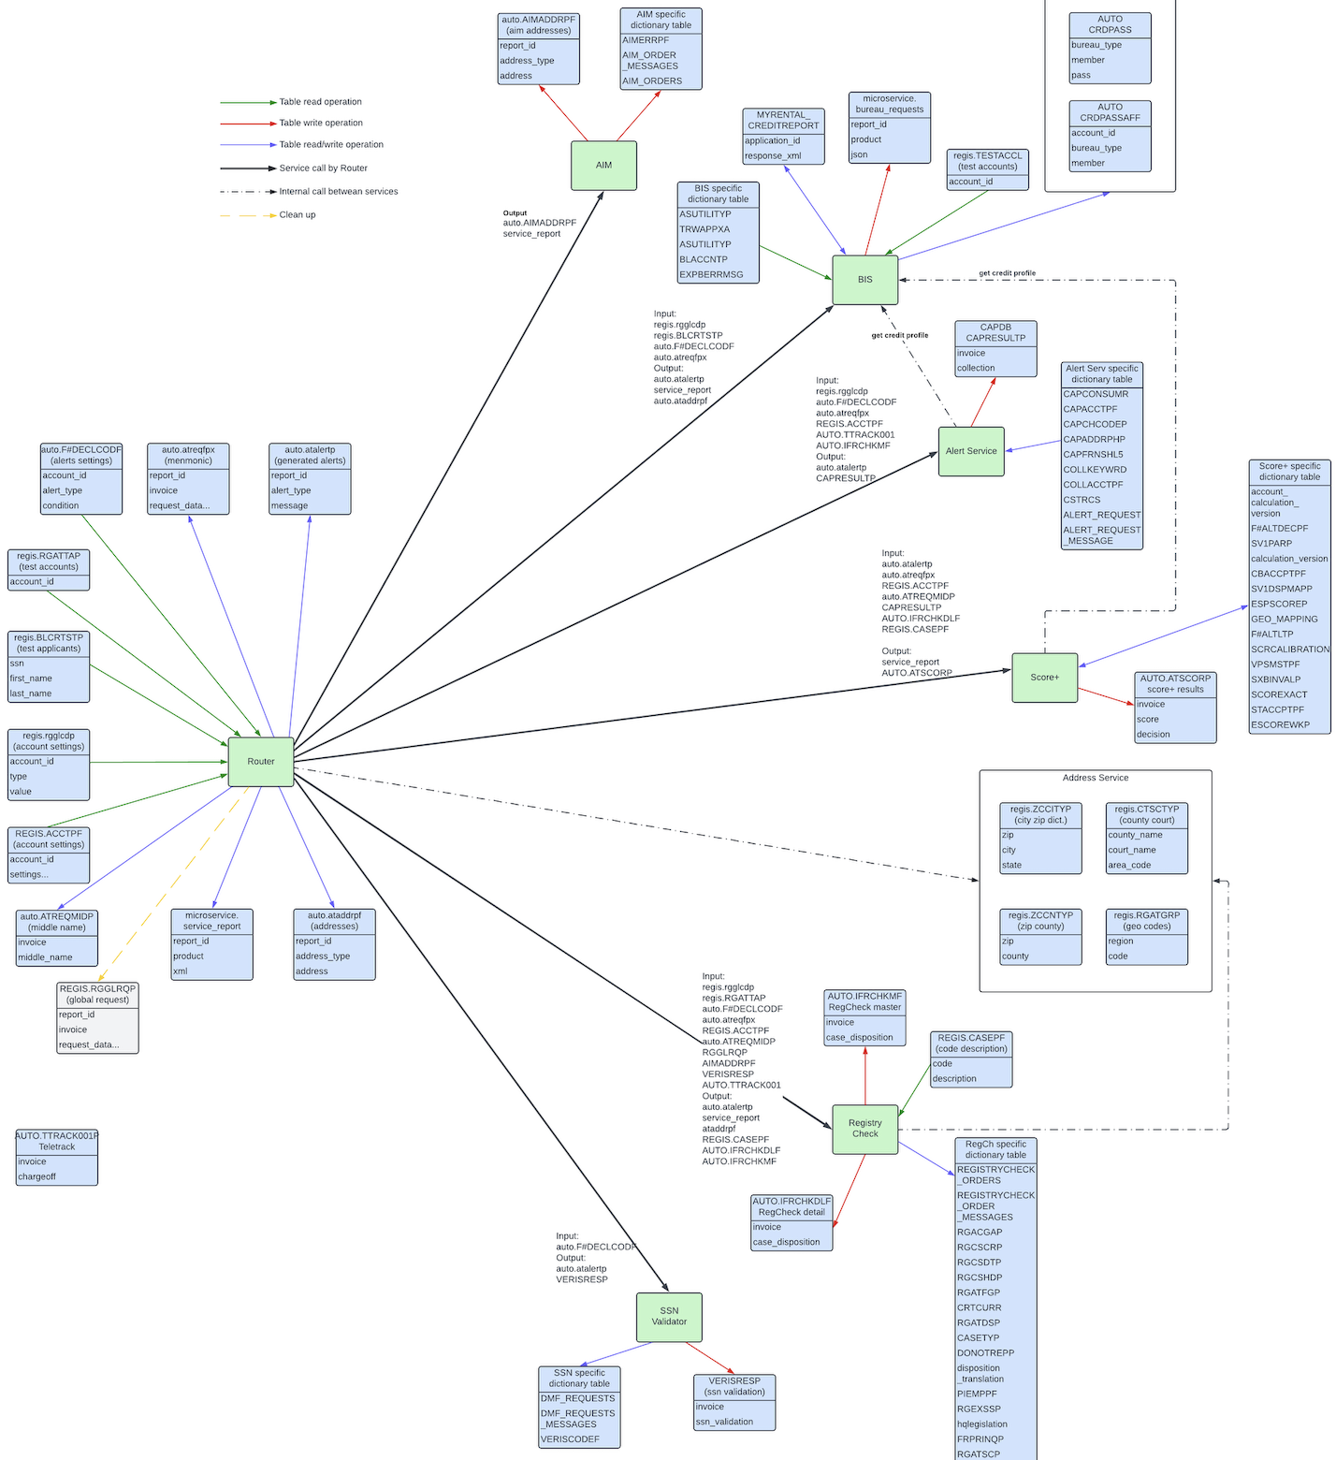
SFRN-DEVT: future state
Solution: left side – deployment diagram, right side - dependencies between microservices(DB tables).

Slide 19
SFRN-DEVT: services migration project
Project outcomes:
Deliver new products to market takes 4 weeks (Previously were 3-6 months)
Deployment duration takes 5 mins without downtime (Previously was manual deployment which took whole Sunday)
Support team was decreased from 5 members to 1 (system became more stable and added automation to daily monitor process)
Reduced amount of release rollbacks to 0 (added automation testing, full CI/CD, added code review processes and static code quality tools)

Slide 20
SFRN-DEVT: executive summary
SafeRent company is currently facing several business problems including increased customer attrition and a decrease in revenue. To address these challenges SafeRent is looking for applications migration and processes improvement solution to achieve business goals like consistent customer grow, decreasing operational costs, enhancing customer satisfaction, reducing time to market for new products, and cutting the number of court cases against the company.
To achieve these goals, specific business objectives have been identified that involve significant technological upgrades and process improvements. These objectives include migrating legacy IBM AS400 platform to a modern on-premise/cloud architecture, rewriting all source code to a modern language, building a robust Software Development Life Cycle (SDLC), and implementing the Scrum methodology in software development process.
The migration to a modern architecture will drastically reduce operational costs and provide the scalability needed to support customer growth. Rewriting the source code will allow to deliver new products faster and with fewer issues, directly addressing our goal to decrease time to market. Establishing a comprehensive SDLC will minimize software defects and enhance the efficiency of our software delivery, leading to increased customer satisfaction. Lastly, adopting the Scrum methodology will increase the frequency of product releases, enabling us to be more responsive to customer feedback and adapt quickly to market changes.
Migration will be completed in two phases. First is to migrate as is business logic to a set of Java Spring Boot applications which will operate with PostgreSQL Database and build robust, automated release strategy. Second is to enhance, improve business products, refactor Java application, split Database and deploy this solution to cloud provider.

Slide 21
Thank you!

